Slide 1
CISCO INTERNSHIP Project
Project – Design secure network for your instuition
By – Induja a
2nd year cse-b
Sri sairam engineering college

Slide 2
Objective :
To Create Sri SaiRam Engineering College Network structure for minimum 5 departments and the scenario is as follows : 1. 5 Switches (Cisco 2950 switch) 2. 1 Router (Cisco 1841 router) 3. Minimum 5 Computer Systems (Generic) per Lab/Dept 4. 1 Computer system for server 5. Appropriate Cables should be used for connectivity 6. Assign static IP to all devices and ensure network connectivity available between different labs. Based on the knowledge gained in this Cybersecurity Course add the necessary components to this Scenario.

Slide 3
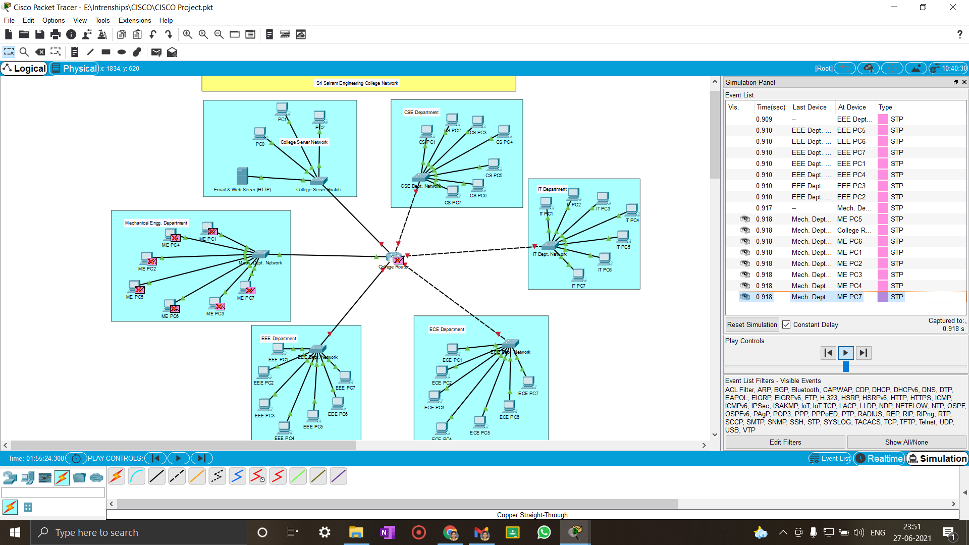
Layout :

Slide 4
Devices used in this network
5 Switches (Cisco 2950 switch)
1 Routers (Cisco 1841 router)
5 Computer Systems (Generic) per Lab/Dept
1 Computer System for server
Appropriate Cables for connectivity

Slide 5
What is star topology?
A star topology is a topology for a Local Area Network (LAN) in which all nodes are individually connected to a central connection point, like a hub or a switch. A star takes more cable than e.g. a bus, but the benefit is that if a cable fails, only one node will be brought down.

Slide 6
Advantages of Star Topology
It is very reliable – if one cable or device fails then all the others will still work
It is high-performing as no data collisions can occur
Less expensive because each device only need one I/O port and wishes to be connected with hub with one link.
Easier to put in
Robust in nature
Easy fault detection because the link are often easily identified.
No disruptions to the network when connecting or removing devices.
Each device requires just one port i.e. to attach to the hub.
If N devices are connected to every other in star, then the amount of cables required to attach them is N. So, it’s easy to line up.

Slide 7
Disadvantages of Star Topology
Requires more cable than a linear bus .
If the connecting network device (network switch) fails, nodes attached are disabled and can’t participate in network communication.
More expensive than linear bus topology due to the value of the connecting devices (network switches)
If hub goes down everything goes down, none of the devices can work without hub.
Hub requires more resources and regular maintenance because it’s the central system of star .
Extra hardware is required (hubs or switches) which adds to cost
Performance is predicated on the one concentrator i.e. hub.

Slide 8
Attacks expected :
Denial-of-service (DoS) attacks.
Phishing and spear phishing attacks
Malware attack
Man-in-the-middle (MitM) attack

Slide 9
Solution :
Man-in-the-middle (MitM) attack :
Strong WEP/WAP Encryption on Access Points
Having a strong encryption mechanism on wireless access points prevents unwanted users from joining your network just by being nearby. A weak encryption mechanism can allow an attacker to brute-force his way into a network and begin man-in-the-middle attacking. The stronger the encryption implementation, the safer.

